Slide 1
Deterministic randomised algorithms
Jiaheng Wang
University of Helsinki

Slide 2
(Much) faster randomised algorithms
Jiaheng Wang
University of Helsinki

Slide 3
Independent set
occupied
unoccupied

Slide 4
Independent set
occupied
–
+
–
+
–
+
–
unoccupied

Slide 5
Independent set
#
Hard-core gas model
–
+
$$Δ$$
$$λ$$
–
+
–
maximum
degree
“fugacity”
+
–

Slide 6
$$Δ$$
$$λ$$
Independent set
#
maximum
degree
“fugacity”
Hard-core gas model
Input:
a graph with max degree $≤Δ$
Output:
the partition function
$$Z=\sum_{IndSet σ}{λ^{\left|σ\right|}}$$

Slide 7
$$Δ$$
$$λ$$
Independent set
#
maximum
degree
“fugacity”
Hard-core gas model
Input:
–
a graph with max degree $≤Δ$
+
Output:
–
+
the partition function
–
$$Z=\sum_{IndSet σ}{λ^{\left|σ\right|}}$$
+
–
$$λ^{3}$$

Slide 8
–
configuration
+
–
+
weight
–
+
$$π\left(σ\right)=\frac{λ^{\left|σ\right|}}{Z}$$
–
the partition function
$$Z=\sum_{IndSet σ}{λ^{\left|σ\right|}}$$
partition function

Slide 9
$$Δ$$
$$λ$$
Independent set
#
maximum
degree
“fugacity”
Hard-core gas model
Input:
–
a graph with max degree $≤Δ$
+
Output:
–
+
sample the Gibbs distribution
–
$$π\left(σ\right)=\frac{λ^{\left|σ\right|}}{Z}$$
+
–
$$λ^{3}/Z$$

Slide 10
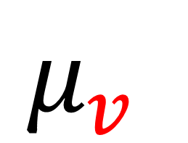
Hard-core gas model
$$Z=\sum_{IndSet σ}{λ^{\left|σ\right|}}$$
$$π\left(σ\right)=\frac{λ^{\left|σ\right|}}{Z}$$
$$μ_{v}$$
Approximate counting
Uniform
sampling

Slide 11
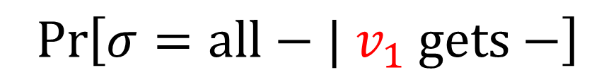
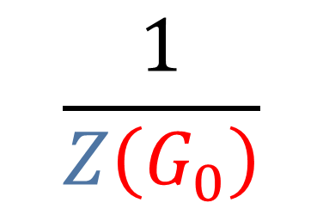
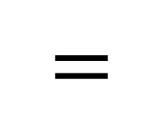
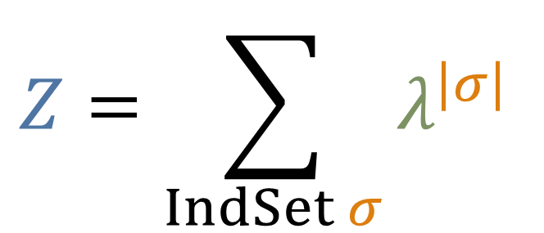

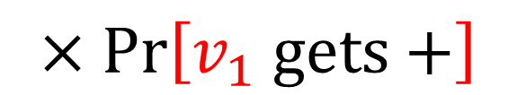
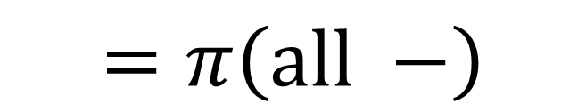
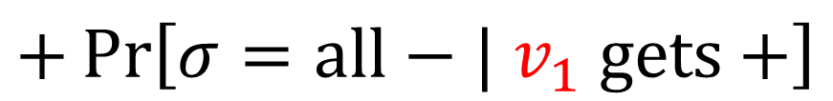
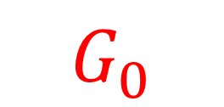
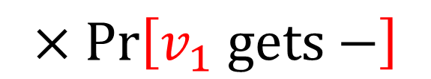
Hard-core gas model
$$G_{0}$$
$$v_{1}$$
$$\frac{1}{Z\left(G_{0}\right)}$$
$$Z=\sum_{IndSet σ}{λ^{\left|σ\right|}}$$
$$=π\left(all −\right)$$
$$=$$
$$\operatorname{Pr}\left[σ=all−| v_{1} gets−\right]$$
$$×\operatorname{Pr}\left[v_{1} gets−\right]$$
$$+\operatorname{Pr}\left[σ=all−| v_{1} gets+\right]$$
$$×\operatorname{Pr}\left[v_{1} gets+\right]$$

Slide 12
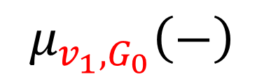
Hard-core gas model
$$G_{0}$$
$$v_{1}$$
$$\frac{1}{Z\left(G_{0}\right)}$$
$$Z=\sum_{IndSet σ}{λ^{\left|σ\right|}}$$
$$=π\left(all −\right)$$
$$=$$
$$\operatorname{Pr}\left[σ=all−| v_{1} gets−\right]$$
$$μ_{v_{1},G_{0}}\left(−\right)$$

Slide 13
Hard-core gas model
$$G_{0}$$
$$v_{1}$$
–
$$\frac{1}{Z\left(G_{0}\right)}$$
$$Z=\sum_{IndSet σ}{λ^{\left|σ\right|}}$$
$$=π\left(all −\right)$$
$$=$$
$$\operatorname{Pr}\left[σ=all−| v_{1} gets−\right]$$
$$μ_{v_{1},G_{0}}\left(−\right)$$

Slide 14
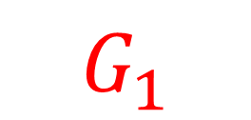
Hard-core gas model
$$G_{1}$$
$$\frac{1}{Z\left(G_{0}\right)}$$
$$Z=\sum_{IndSet σ}{λ^{\left|σ\right|}}$$
$$=π\left(all −\right)$$
$$=$$
$$\operatorname{Pr}\left[σ=all−| v_{1} gets−\right]$$
$$μ_{v_{1},G_{0}}\left(−\right)$$

Slide 15

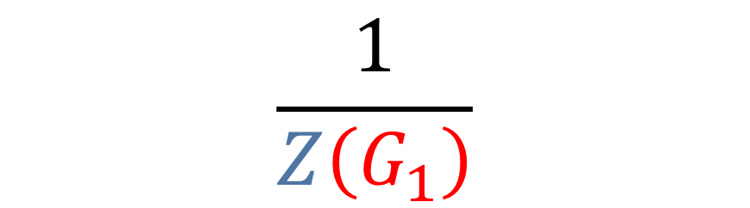
Hard-core gas model
$$G_{1}$$
$$\frac{1}{Z\left(G_{0}\right)}$$
$$Z=\sum_{IndSet σ}{λ^{\left|σ\right|}}$$
$$v_{2}$$
$$\frac{1}{Z\left(G_{1}\right)}$$
$$=$$
$$μ_{v_{1},G_{0}}\left(−\right)$$

Slide 16
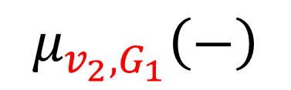


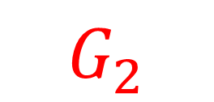
Self-reduction
Hard-core gas model
$$G_{2}$$
$$\frac{1}{Z\left(G_{0}\right)}$$
$$Z=\sum_{IndSet σ}{λ^{\left|σ\right|}}$$
$$\frac{1}{Z\left(G_{2}\right)}$$
$$=$$
$$μ_{v_{1},G_{0}}\left(−\right)$$
$$μ_{v_{2},G_{1}}\left(−\right)$$

Slide 17
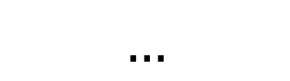



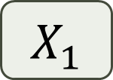
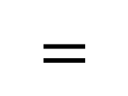
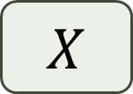

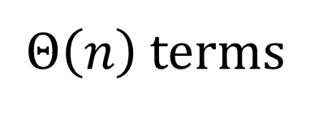
$$G_{2}$$
Hard-core gas model
Self-reduction
$$Z=\sum_{IndSet σ}{λ^{\left|σ\right|}}$$
time
to draw a sample
Requires samples
$$X_{1}$$
???
???
$$\frac{1}{Z\left(G_{0}\right)}$$
estimate
$$=$$
$$…$$
$$X$$
$$μ_{v_{1},G_{0}}\left(−\right)$$
$$μ_{v_{2},G_{1}}\left(−\right)$$
$Θ\left(n\right)$ terms
Monte-Carlo method

Slide 18

$$G_{2}$$
Hard-core gas model
Self-reduction
$$Z=\sum_{IndSet σ}{λ^{\left|σ\right|}}$$
time
to draw a sample
Requires samples
???
$$Θ\left(n\right)$$
$$X_{1}$$
$$\frac{1}{Z\left(G_{0}\right)}$$
estimate
$$=$$
$$…$$
$$X$$
$$μ_{v_{1},G_{0}}\left(−\right)$$
$$μ_{v_{2},G_{1}}\left(−\right)$$
$Θ\left(n\right)$ terms
Monte-Carlo method

Slide 21
?

Slide 23
?
A

Slide 24
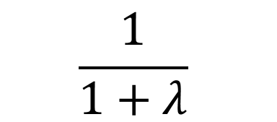
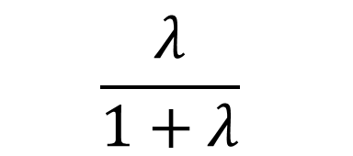
A
$$\frac{λ}{1+λ}$$
?
$$\frac{1}{1+λ}$$

Slide 25
A

Slide 26
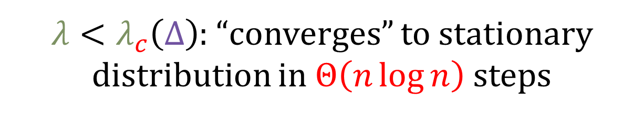
A
$λ<λ_{c}\left(Δ\right)$: “converges” to stationary distribution in $Θ\left(n\log{n}\right)$ steps
“Glauber dynamics”
This was only proved in 2021

Slide 27

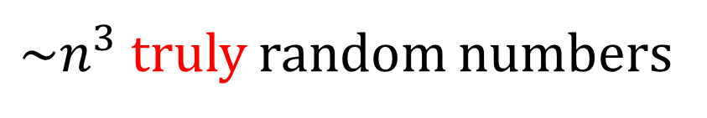
$$G_{2}$$
Hard-core gas model
Did you see the waste of Markov chain?
Self-reduction
$$Θ\left(n\log{n}\right)$$
$$Z=\sum_{IndSet σ}{λ^{\left|σ\right|}}$$
time
to draw a sample
Requires samples
$$Θ\left(n\right)$$
$$X_{1}$$
$$\frac{1}{Z\left(G_{0}\right)}$$
estimate
$$=$$
$$…$$
$$X$$
$$μ_{v_{1},G_{0}}\left(−\right)$$
$$μ_{v_{2},G_{1}}\left(−\right)$$
$Θ\left(n\right)$ terms
Markov-chain Monte-Carlo method
$\sim n^{3}$ truly random numbers

Slide 28
$$G_{2}$$
Hard-core gas model
Did you see the waste of Markov chain?
Self-reduction
$$Θ\left(n\log{n}\right)$$
$$Z=\sum_{IndSet σ}{λ^{\left|σ\right|}}$$
time
to draw a sample
Requires samples
$$Θ\left(n\right)$$
$$X_{1}$$
$$\frac{1}{Z\left(G_{0}\right)}$$
estimate
$$=$$
$$…$$
$$X$$
$$μ_{v_{1},G_{0}}\left(−\right)$$
$$μ_{v_{2},G_{1}}\left(−\right)$$
$Θ\left(n\right)$ terms
Markov-chain Monte-Carlo method
$\sim n^{3}$ truly random numbers

Slide 29
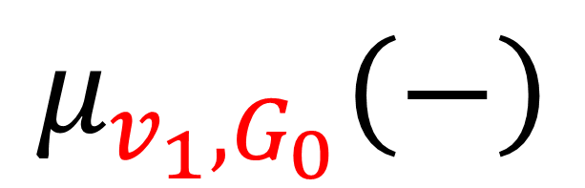
$$G_{2}$$
Hard-core gas model
Did you see the waste of Markov chain?
Self-reduction
$$Θ\left(n\log{n}\right)$$
$$Z=\sum_{IndSet σ}{λ^{\left|σ\right|}}$$
time
to draw a sample
Requires samples
$$Θ\left(n\right)$$
$$X_{1}$$
$$\frac{1}{Z\left(G_{0}\right)}$$
$$μ_{v_{1},G_{0}}\left(−\right)$$
estimate
$$=$$
$$…$$
$$X$$
$$μ_{v_{2},G_{1}}\left(−\right)$$
$Θ\left(n\right)$ terms
Markov-chain Monte-Carlo method
$\sim n^{3}$ truly random numbers

Slide 30


$$μ_{v_{1},G_{0}}\left(−\right)$$
$$v_{1}$$

Slide 31
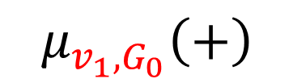











$$μ_{v_{1},G_{0}}\left(+\right)$$
$$=$$
$$\operatorname{Pr}\left[v_{1}+ | v_{2}v_{3}v_{4}− − −\right]$$
$$μ_{v_{1},G_{0}}\left(−\right)$$
$$×$$
$$\operatorname{Pr}\left[v_{2}v_{3}v_{4}− − −\right]$$
$$v_{3}$$
$$v_{1}$$
$$+\operatorname{Pr}\left[v_{1}+ | v_{2}v_{3}v_{4}− − +\right]$$
$$×$$
$$\operatorname{Pr}\left[v_{2}v_{3}v_{4}− − +\right]$$
$$+…$$
$$v_{2}$$
$$v_{4}$$

Slide 32
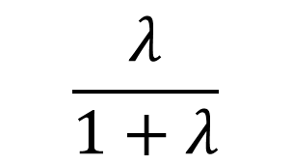

$$\frac{λ}{1+λ}$$
$$μ_{v_{1},G_{0}}\left(+\right)$$
$$=$$
$$\operatorname{Pr}\left[v_{2}v_{3}v_{4}− − −\right]$$
$$μ_{v_{1},G_{0}}\left(−\right)$$
$$v_{3}$$
$$v_{1}$$
$$v_{2}$$
$$v_{4}$$

Slide 33

$$μ_{v_{1},G_{0}}\left(−\right)$$
$$v_{3}$$
$$v_{1}$$
$$v_{2}$$
$$v_{4}$$
$$μ_{v_{2}v_{3}v_{4},G_{0}}\left(−^{3}\right)$$

Slide 34
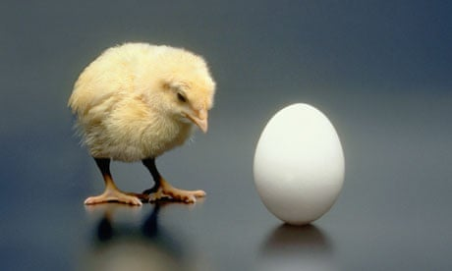
$$μ_{v_{1},G_{0}}\left(−\right)$$
$$v_{3}$$
$$v_{1}$$
$$v_{2}$$
$$v_{4}$$
Always happens!
$$μ_{v_{2}v_{3}v_{4},G_{0}}\left(−^{3}\right)$$

Slide 35

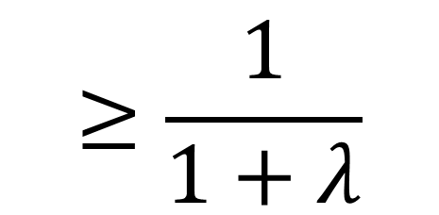
$$≥\frac{1}{1+λ}$$
$$μ_{v_{1},G_{0}}\left(−\right)$$
$$v_{1}$$

Slide 36

$$≥\frac{1}{1+λ}$$
$$σ$$
$$μ_{v_{1},G_{0}}\left(−\right)$$
$$v_{1}$$
+
-
-
+

Slide 37
$$≥\frac{1}{1+λ}$$
$$μ_{v_{1},G_{0}}\left(−\right)$$
$$v_{1}$$

Slide 38


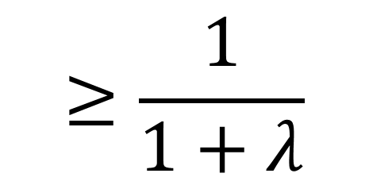
$$≥\frac{1}{1+λ}$$
$$μ_{v_{1},G_{0}}\left(−\right)$$
$$v_{1}$$
+
+
-
?
+
-
-
-
-
-

Slide 39


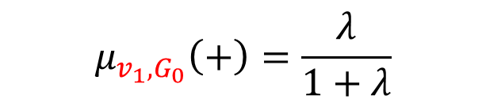
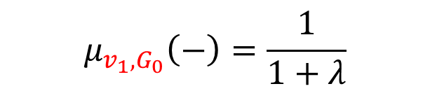


$$≥\frac{1}{1+λ}$$
$$μ_{v_{1},G_{0}}\left(−\right)$$
-
$$μ_{v_{1},G_{0}}\left(−\right)=\frac{1}{1+λ}$$
-
$$μ_{v_{1},G_{0}}\left(+\right)=\frac{λ}{1+λ}$$
$$v_{1}$$
-
?
+
$$μ_{v_{1},G_{0}}\left(−\right)=1$$
-
$$μ_{v_{1},G_{0}}\left(+\right)=0$$
-
+
$$μ_{v_{1},G_{0}}\left(−\right)=1$$
+
$$μ_{v_{1},G_{0}}\left(+\right)=0$$
-

Slide 40

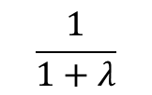





$$≥\frac{1}{1+λ}$$
$$μ_{v_{1},G_{0}}\left(−\right)$$
-
$$0$$
$$\frac{1}{1+λ}$$
$$1$$
-
+
-
$$v_{1}$$
-
?
+
$$0$$
$$1$$
-
-
-
+
$$0$$
$$1$$
+
-
-

Slide 41
$$≥\frac{1}{1+λ}$$
$$μ_{v_{1},G_{0}}\left(−\right)$$
-
$$0$$
$$\frac{1}{1+λ}$$
$$1$$
-
+
-
$$v_{1}$$
-
-
?
+
$$0$$
$$1$$
-
-
-
-
-
+
$$0$$
$$1$$
+
-
-

Slide 42
$$≥\frac{1}{1+λ}$$
$$μ_{v_{1},G_{0}}\left(−\right)$$
-
$$0$$
$$\frac{1}{1+λ}$$
$$1$$
-
+
-
$$v_{1}$$
-
-
?
+
$$0$$
$$1$$
-
-
-
-
-
+
$$0$$
$$1$$
+
-
-

Slide 43
$$≥\frac{1}{1+λ}$$
$$μ_{v_{1},G_{0}}\left(−\right)$$
-
$$0$$
$$\frac{1}{1+λ}$$
$$1$$
-
+
-
$$v_{1}$$
-
-
+
+
$$0$$
$$1$$
-
-
-
-
-
+
$$0$$
$$1$$
+
-
-

Slide 44
$$≥\frac{1}{1+λ}$$
$$μ_{v_{1},G_{0}}\left(−\right)$$
-
$$0$$
$$\frac{1}{1+λ}$$
$$1$$
-
+
-
$$v_{1}$$
-
?
+
$$0$$
$$1$$
-
-
-
+
$$0$$
$$1$$
+
-
-

Slide 45
$$≥\frac{1}{1+λ}$$
$$μ_{v_{1},G_{0}}\left(−\right)$$
-
$$0$$
$$\frac{1}{1+λ}$$
$$1$$
-
+
-
$$v_{1}$$
-
?
+
$$0$$
$$1$$
-
-
-
+
$$0$$
$$1$$
+
-
-

Slide 46
$$≥\frac{1}{1+λ}$$
$$μ_{v_{1},G_{0}}\left(−\right)$$
-
$$0$$
$$\frac{1}{1+λ}$$
$$1$$
-
+
-
$$v_{1}$$
-
-
+
$$0$$
$$1$$
-
-
-
+
$$0$$
$$1$$
+
-
-

Slide 47


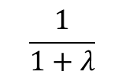
$$≥\frac{1}{1+λ}$$
$$μ_{v_{1},G_{0}}\left(−\right)$$
-
$$0$$
$$\frac{1}{1+λ}$$
$$1$$
-
+
-
$$v_{1}$$
-
?
+
$$0$$
$$1$$
-
-
-
+
$$0$$
$$1$$
+
-
-
$$0$$
$$\frac{1}{1+λ}$$
$$1$$
-
ZOI

Slide 48






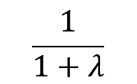
$$≥\frac{1}{1+λ}$$
$$μ_{v_{1},G_{0}}\left(−\right)$$
-
$$0$$
$$\frac{1}{1+λ}$$
$$1$$
-
+
-
$$v_{1}$$
+
-
$$0$$
$$1$$
?
-
-
+
-
$$0$$
$$1$$
+
-
-
$$0$$
$$\frac{1}{1+λ}$$
$$1$$
-
ZOI
Lower bound distribution

Slide 49
$$≥\frac{1}{1+λ}$$
$$μ_{v_{1},G_{0}}\left(−\right)$$
-
$$0$$
$$\frac{1}{1+λ}$$
$$1$$
-
+
-
$$v_{1}$$
+
-
$$0$$
$$1$$
-
-
-
+
-
$$0$$
$$1$$
+
-
-
$$0$$
$$\frac{1}{1+λ}$$
$$1$$
-
ZOI
Lower bound distribution

Slide 50
$$≥\frac{1}{1+λ}$$
$$μ_{v_{1},G_{0}}\left(−\right)$$
-
$$0$$
$$\frac{1}{1+λ}$$
$$1$$
-
+
-
$$v_{1}$$
+
-
$$0$$
$$1$$
?
?
?
-
-
+
-
$$0$$
$$1$$
+
-
-
$$0$$
$$\frac{1}{1+λ}$$
$$1$$
-
ZOI
Lower bound distribution

Slide 51
$$≥\frac{1}{1+λ}$$
$$μ_{v_{1},G_{0}}\left(−\right)$$
-
$$0$$
$$\frac{1}{1+λ}$$
$$1$$
-
+
-
$$v_{1}$$
+
?
$$0$$
$$1$$
-
-
-
+
-
$$0$$
$$1$$
?
+
-
?
-
$$0$$
$$\frac{1}{1+λ}$$
$$1$$
-
ZOI
Lower bound distribution

Slide 52
$$≥\frac{1}{1+λ}$$
$$μ_{v_{1},G_{0}}\left(−\right)$$
-
$$0$$
$$\frac{1}{1+λ}$$
$$1$$
-
+
-
$$v_{1}$$
+
?
$$0$$
$$1$$
-
-
-
+
-
$$0$$
$$1$$
-
+
-
?
-
$$0$$
$$\frac{1}{1+λ}$$
$$1$$
(conditioning to ensure correct joint probability)
-
ZOI
Lower bound distribution

Slide 53
$$≥\frac{1}{1+λ}$$
$$μ_{v_{1},G_{0}}\left(−\right)$$
-
$$0$$
$$\frac{1}{1+λ}$$
$$1$$
-
+
-
$$v_{1}$$
+
?
$$0$$
$$1$$
-
-
-
+
-
$$0$$
$$1$$
-
+
-
-
-
$$0$$
$$\frac{1}{1+λ}$$
$$1$$
(conditioning to ensure correct joint probability)
-
ZOI
Lower bound distribution

Slide 54
$$≥\frac{1}{1+λ}$$
$$μ_{v_{1},G_{0}}\left(−\right)$$
-
$$0$$
$$\frac{1}{1+λ}$$
$$1$$
-
+
-
$$v_{1}$$
+
-
-
$$0$$
$$1$$
-
-
+
-
$$0$$
$$1$$
-
+
-
-
-
$$0$$
$$\frac{1}{1+λ}$$
$$1$$
-
ZOI
Lower bound distribution

Slide 55




$$≥\frac{1}{1+λ}$$
$$μ_{v_{1},G_{0}}\left(−\right)$$
-
$$0$$
$$\frac{1}{1+λ}$$
$$1$$
-
+
-
$$v_{1}$$
+
-
-
$$0$$
$$1$$
?
-
-
+
-
$$0$$
$$1$$
-
+
-
-
-
$$0$$
$$\frac{1}{1+λ}$$
$$1$$
-
ZOI
Lower bound distribution

Slide 56
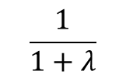


$$≥\frac{1}{1+λ}$$
$$μ_{v_{1},G_{0}}\left(−\right)$$
$$v_{1}$$
+
-
$$0$$
$$1$$
?
-
$$0$$
$$\frac{1}{1+λ}$$
$$1$$
-
-
+
-
+
-
$$0$$
$$1$$
-
-
+
-
-
-
-
$$0$$
$$\frac{1}{1+λ}$$
$$1$$
-
ZOI
Lower bound distribution

Slide 57
$$≥\frac{1}{1+λ}$$
$$μ_{v_{1},G_{0}}\left(−\right)$$
Overflow distribution
$$v_{1}$$
+
-
$$0$$
$$1$$
?
-
$$0$$
$$\frac{1}{1+λ}$$
$$1$$
-
-
+
-
+
-
$$0$$
$$1$$
-
-
+
-
-
-
-
$$0$$
$$\frac{1}{1+λ}$$
$$1$$
-
ZOI
Lower bound distribution

Slide 58
$$≥\frac{1}{1+λ}$$
$$μ_{v_{1},G_{0}}\left(−\right)$$
$$v_{1}$$
+
-
$$0$$
$$1$$
?
-
$$0$$
$$\frac{1}{1+λ}$$
$$1$$
-
-
+
-
+
-
$$0$$
$$1$$
-
-
+
-
-
-
-
$$0$$
$$\frac{1}{1+λ}$$
$$1$$
-
ZOI
Lower bound distribution

Slide 59
$$≥\frac{1}{1+λ}$$
$$μ_{v_{1},G_{0}}\left(−\right)$$
$$v_{1}$$
+
-
$$0$$
$$1$$
?
-
$$0$$
$$\frac{1}{1+λ}$$
$$1$$
-
-
+
-
+
-
$$0$$
$$1$$
-
-
+
-
-
-
-
$$0$$
$$\frac{1}{1+λ}$$
$$1$$
-
ZOI
Lower bound distribution

Slide 60
$$≥\frac{1}{1+λ}$$
$$μ_{v_{1},G_{0}}\left(−\right)$$
Local sampler
$$v_{1}$$
+
-
$$0$$
$$1$$
+
-
$$0$$
$$\frac{1}{1+λ}$$
$$1$$
-
-
+
-
+
-
$$0$$
$$1$$
-
-
+
-
-
-
-
$$0$$
$$\frac{1}{1+λ}$$
$$1$$
-
ZOI
Lower bound distribution

Slide 61
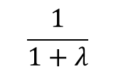
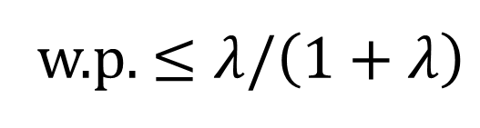


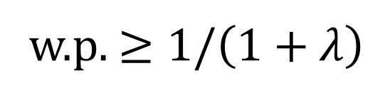
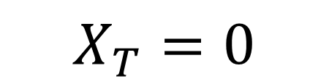


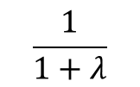
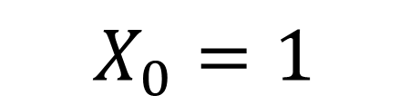


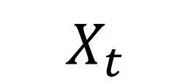
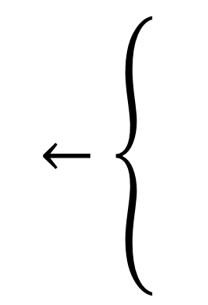
-
$$0$$
$$\frac{1}{1+λ}$$
$$1$$
-
-
+
-
Local sampler
$$v_{1}$$
$$0$$
$$\frac{1}{1+λ}$$
$$1$$
-
ZOI
$$←\left\{\begin{aligned} \\ \\ \\ \end{aligned}\right.$$
$$X_{t−1}−1$$
w.p. $≥1/\left(1+λ\right)$
$$X_{t}$$
$$X_{t−1}+Δ−1$$
$$X_{0}=1$$
$$X_{T}=0$$
w.p. $≤λ/\left(1+λ\right)$
Lower bound distribution

Slide 62
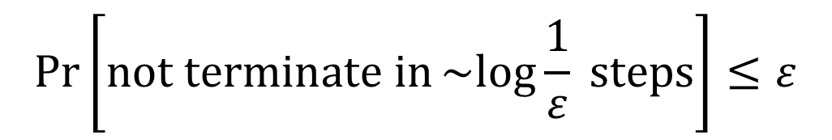
-
$$0$$
$$\frac{1}{1+λ}$$
$$1$$
-
-
+
-
Local sampler
$$v_{1}$$
$$0$$
$$\frac{1}{1+λ}$$
$$1$$
-
ZOI
$$\operatorname{Pr}\left[not terminate in\sim log{\frac{1}{ε}} steps\right]≤ε$$
Lower bound distribution

Slide 63
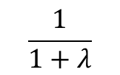


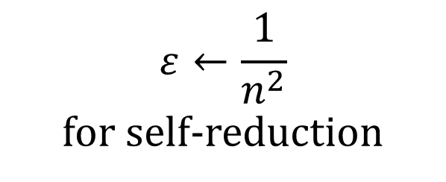
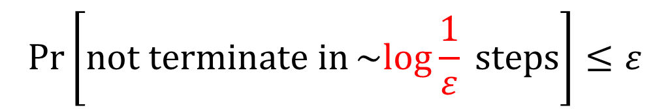
$$0$$
$$\frac{1}{1+λ}$$
$$1$$
-
-
ZOI
$$0$$
$$\frac{1}{1+λ}$$
$$1$$
-
-
+
-
Local sampler
$$v_{1}$$
$$\operatorname{Pr}\left[not terminate in\sim log{\frac{1}{ε}} steps\right]≤ε$$
$$ε←\frac{1}{n^{2}}$$
for self-reduction
Lower bound distribution

Slide 64
$$G_{2}$$
Hard-core gas model
Self-reduction
$$Θ\left(n\log{n}\right)$$
$$Z=\sum_{IndSet σ}{λ^{\left|σ\right|}}$$
time
to draw a sample
Requires samples
$$Θ\left(n\right)$$
$$X_{1}$$
$$\frac{1}{Z\left(G_{0}\right)}$$
estimate
$$=$$
$$…$$
$$X$$
$$μ_{v_{1},G_{0}}\left(−\right)$$
$$μ_{v_{2},G_{1}}\left(−\right)$$
$Θ\left(n\right)$ terms
Markov-chain Monte-Carlo method
$\sim n^{3}$ truly random numbers

Slide 65


$$G_{2}$$
Hard-core gas model
Self-reduction
$$Θ\left(\log{n}\right)$$
$$Z=\sum_{IndSet σ}{λ^{\left|σ\right|}}$$
time
to draw a sample
Requires samples
$$Θ\left(n\right)$$
$$X_{1}$$
$$\frac{1}{Z\left(G_{0}\right)}$$
estimate
$$=$$
$$…$$
$$X$$
$$μ_{v_{1},G_{0}}\left(−\right)$$
$$μ_{v_{2},G_{1}}\left(−\right)$$
$Θ\left(n\right)$ terms
Local sampler Monte-Carlo method
$\sim n^{2}$ truly random numbers

Slide 66
$$G_{2}$$
Hard-core gas model
Self-reduction
$$Θ\left(\log{n}\right)$$
$$Z=\sum_{IndSet σ}{λ^{\left|σ\right|}}$$
time
to draw a sample
Requires samples
$$Θ\left(n\right)$$
$$X_{1}$$
$$\frac{1}{Z\left(G_{0}\right)}$$
estimate
$$=$$
$$…$$
$$X$$
$$μ_{v_{1},G_{0}}\left(−\right)$$
$$μ_{v_{2},G_{1}}\left(−\right)$$
$Θ\left(n\right)$ terms
Local sampler Monte-Carlo method
$\sim n^{2}$ truly random numbers

Slide 67
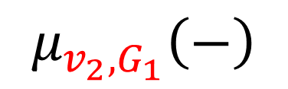
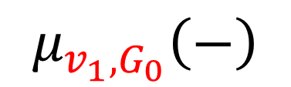
$$G_{2}$$
Hard-core gas model
Self-reduction
$$μ_{v_{1},G_{0}}\left(−\right)$$
$$μ_{v_{2},G_{1}}\left(−\right)$$
$$Z=\sum_{IndSet σ}{λ^{\left|σ\right|}}$$
$$X_{1}$$
$$\frac{1}{Z\left(G_{0}\right)}$$
estimate
$$=$$
$$…$$
$$X$$
Local sampler Monte-Carlo method
$\sim n^{2}$ truly random numbers

Slide 68


















$n$ estimators
$$μ_{v_{1},G_{0}}\left(−\right)$$
$$μ_{v_{2},G_{1}}\left(−\right)$$
$$𝒜\left(v_{1},G_{0}, \right)$$
$$𝒜\left(v_{2},G_{1}, \right)$$
$$\log{n}$$
$$\log{n}$$
$$𝒜\left(v_{1},G_{0}, \right)$$
$$𝒜\left(v_{2},G_{1}, \right)$$
$$\log{n}$$
$$\log{n}$$
$n$ samples
$$𝒜\left(v_{1},G_{0}, \right)$$
$$𝒜\left(v_{2},G_{1}, \right)$$
$$\log{n}$$
$$\log{n}$$
$$𝒜\left(v_{1},G_{0}, \right)$$
Brute-force enumeration
$$𝒜\left(v_{2},G_{1}, \right)$$
Brute-force enumeration
$$\log{n}$$
$$\log{n}$$

Slide 69
Recipe
$n$ estimators
$$μ_{v_{1},G_{0}}\left(−\right)$$
$$μ_{v_{2},G_{1}}\left(−\right)$$
$$𝒜\left(v_{1},G_{0}, \right)$$
$$𝒜\left(v_{2},G_{1}, \right)$$
$$\log{n}$$
$$\log{n}$$
$$𝒜\left(v_{1},G_{0}, \right)$$
$$𝒜\left(v_{2},G_{1}, \right)$$
$$\log{n}$$
$$\log{n}$$
$n$ samples
$$𝒜\left(v_{1},G_{0}, \right)$$
$$𝒜\left(v_{2},G_{1}, \right)$$
$$\log{n}$$
$$\log{n}$$
$$𝒜\left(v_{1},G_{0}, \right)$$
$$𝒜\left(v_{2},G_{1}, \right)$$
$$\log{n}$$
$$\log{n}$$

Slide 70
Recipe
$n$ estimators
$$μ_{v_{1},G_{0}}\left(−\right)$$
$$μ_{v_{2},G_{1}}\left(−\right)$$
$$𝒜\left(v_{1},G_{0}, \right)$$
$$𝒜\left(v_{2},G_{1}, \right)$$
$$\log{n}$$
$$\log{n}$$
$$𝒜\left(v_{1},G_{0}, \right)$$
$$𝒜\left(v_{2},G_{1}, \right)$$
$$\log{n}$$
1. “Direct-sum” decomposition of randomness usage
$$\log{n}$$
$n$ samples
$$𝒜\left(v_{1},G_{0}, \right)$$
$$𝒜\left(v_{2},G_{1}, \right)$$
$$\log{n}$$
$$\log{n}$$
$$𝒜\left(v_{1},G_{0}, \right)$$
$$𝒜\left(v_{2},G_{1}, \right)$$
$$\log{n}$$
$$\log{n}$$

Slide 71
Recipe
$n$ estimators
$$μ_{v_{1},G_{0}}\left(−\right)$$
$$μ_{v_{2},G_{1}}\left(−\right)$$
$$𝒜\left(v_{1},G_{0}, \right)$$
$$𝒜\left(v_{2},G_{1}, \right)$$
$$\log{n}$$
$$\log{n}$$
$$𝒜\left(v_{1},G_{0}, \right)$$
$$𝒜\left(v_{2},G_{1}, \right)$$
$$\log{n}$$
1. “Direct-sum” decomposition of randomness usage
$$\log{n}$$
$n$ samples
$$𝒜\left(v_{1},G_{0}, \right)$$
$$𝒜\left(v_{2},G_{1}, \right)$$
$$\log{n}$$
$$\log{n}$$
2. Early truncation of
“local” Monte Carlo
$$𝒜\left(v_{1},G_{0}, \right)$$
$$𝒜\left(v_{2},G_{1}, \right)$$
$$\log{n}$$
$$\log{n}$$

Slide 72

Derandomising
Markov chain Monte Carlo???
1. “Direct-sum” decomposition of randomness usage
A
2. Early truncation of
“local” Monte Carlo
A
$λ<λ_{c}\left(Δ\right)$: “converges” to stationary distribution in $Θ\left(n\log{n}\right)$ steps

Slide 73
A

Slide 74
?

Slide 75

$$T=0$$
3
6
1
4
7
2
5

Slide 76

$$T=1$$
3
6
1
4
7
2
5

Slide 77

$$T=2$$
3
6
1
4
7
2
5

Slide 78

$$T=3$$
3
6
1
4
7
2
5
Systematic scan
Glauber dynamics

Slide 79
7
6
5
4
3
2
1

Slide 80
7
6
5
4
3
2
1
-20
-19
-18
-17
-16
-15
-14
-13
-12
-11
-10
-9
-8
-7
-6
-5
-4
-3
-2
-1
0

Slide 81
7
6
5
4
3
2
1
-20
-19
-18
-17
-16
-15
-14
-13
-12
-11
-10
-9
-8
-7
-6
-5
-4
-3
-2
-1
0

Slide 82
7
6
5
4
3
2
1
stationary
-20
-19
-18
-17
-16
-15
-14
-13
-12
-11
-10
-9
-8
-7
-6
-5
-4
-3
-2
-1
0

Slide 83
$$0$$
$$\frac{1}{1+λ}$$
$$1$$
7
-
ZOI
6
5
4
3
2
1
stationary
-20
-19
-18
-17
-16
-15
-14
-13
-12
-11
-10
-9
-8
-7
-6
-5
-4
-3
-2
-1
0

Slide 84
$$0$$
$$\frac{1}{1+λ}$$
$$1$$
7
-
ZOI
6
5
4
3
2
1
stationary
-20
-19
-18
-17
-16
-15
-14
-13
-12
-11
-10
-9
-8
-7
-6
-5
-4
-3
-2
-1
0

Slide 85
$$0$$
$$\frac{1}{1+λ}$$
$$1$$
-
7
-
ZOI
6
5
4
3
2
1
stationary
-20
-19
-18
-17
-16
-15
-14
-13
-12
-11
-10
-9
-8
-7
-6
-5
-4
-3
-2
-1
0

Slide 86
$$0$$
$$\frac{1}{1+λ}$$
$$1$$
7
-
ZOI
6
5
4
3
2
1
stationary
-20
-19
-18
-17
-16
-15
-14
-13
-12
-11
-10
-9
-8
-7
-6
-5
-4
-3
-2
-1
0

Slide 87
$$0$$
$$\frac{1}{1+λ}$$
$$1$$
?
7
-
ZOI
6
5
4
3
2
1
stationary
-20
-19
-18
-17
-16
-15
-14
-13
-12
-11
-10
-9
-8
-7
-6
-5
-4
-3
-2
-1
0

Slide 88
$$0$$
$$\frac{1}{1+λ}$$
$$1$$
?
7
-
ZOI
6
5
4
3
2
1
stationary
-20
-19
-18
-17
-16
-15
-14
-13
-12
-11
-10
-9
-8
-7
-6
-5
-4
-3
-2
-1
0

Slide 89
$$0$$
$$\frac{1}{1+λ}$$
$$1$$
?
7
-
ZOI
?
6
?
5
4
3
2
1
stationary
-20
-19
-18
-17
-16
-15
-14
-13
-12
-11
-10
-9
-8
-7
-6
-5
-4
-3
-2
-1
0

Slide 90
$$0$$
$$\frac{1}{1+λ}$$
$$1$$
?
7
-
ZOI
?
6
?
5
4
3
2
1
stationary
-20
-19
-18
-17
-16
-15
-14
-13
-12
-11
-10
-9
-8
-7
-6
-5
-4
-3
-2
-1
0

Slide 91
$$0$$
$$\frac{1}{1+λ}$$
$$1$$
?
7
-
ZOI
?
6
?
5
4
3
2
1
stationary
-20
-19
-18
-17
-16
-15
-14
-13
-12
-11
-10
-9
-8
-7
-6
-5
-4
-3
-2
-1
0

Slide 92
$$0$$
$$\frac{1}{1+λ}$$
$$1$$
?
7
-
ZOI
?
6
?
5
4
3
2
1
stationary
-20
-19
-18
-17
-16
-15
-14
-13
-12
-11
-10
-9
-8
-7
-6
-5
-4
-3
-2
-1
0

Slide 93
$$0$$
$$\frac{1}{1+λ}$$
$$1$$
?
?
7
-
ZOI
?
?
6
?
5
?
4
3
2
1
stationary
-20
-19
-18
-17
-16
-15
-14
-13
-12
-11
-10
-9
-8
-7
-6
-5
-4
-3
-2
-1
0

Slide 94
$$0$$
$$\frac{1}{1+λ}$$
$$1$$
?
?
7
-
ZOI
?
?
6
?
5
?
4
3
2
1
stationary
-20
-19
-18
-17
-16
-15
-14
-13
-12
-11
-10
-9
-8
-7
-6
-5
-4
-3
-2
-1
0

Slide 95
$$0$$
$$\frac{1}{1+λ}$$
$$1$$
?
?
7
-
ZOI
-
?
6
?
5
?
4
3
2
1
stationary
-20
-19
-18
-17
-16
-15
-14
-13
-12
-11
-10
-9
-8
-7
-6
-5
-4
-3
-2
-1
0

Slide 96
$$0$$
$$\frac{1}{1+λ}$$
$$1$$
?
?
7
-
ZOI
-
?
6
?
5
?
4
3
2
1
stationary
-20
-19
-18
-17
-16
-15
-14
-13
-12
-11
-10
-9
-8
-7
-6
-5
-4
-3
-2
-1
0

Slide 97
$$0$$
$$\frac{1}{1+λ}$$
$$1$$
-
?
7
-
ZOI
-
?
6
?
5
?
4
3
2
1
stationary
-20
-19
-18
-17
-16
-15
-14
-13
-12
-11
-10
-9
-8
-7
-6
-5
-4
-3
-2
-1
0

Slide 98
$$0$$
$$\frac{1}{1+λ}$$
$$1$$
-
?
7
-
ZOI
-
?
6
?
5
-
4
3
2
1
stationary
-20
-19
-18
-17
-16
-15
-14
-13
-12
-11
-10
-9
-8
-7
-6
-5
-4
-3
-2
-1
0

Slide 99
$$0$$
$$\frac{1}{1+λ}$$
$$1$$
-
?
7
-
ZOI
-
?
6
?
5
-
4
3
2
1
stationary
-20
-19
-18
-17
-16
-15
-14
-13
-12
-11
-10
-9
-8
-7
-6
-5
-4
-3
-2
-1
0

Slide 100
$$0$$
$$\frac{1}{1+λ}$$
$$1$$
-
?
7
-
ZOI
-
?
6
?
5
-
4
3
2
1
$$0$$
$$\frac{1}{1+λ}$$
$$1$$
-
ZOI
stationary
-20
-19
-18
-17
-16
-15
-14
-13
-12
-11
-10
-9
-8
-7
-6
-5
-4
-3
-2
-1
0

Slide 101
$$0$$
$$\frac{1}{1+λ}$$
$$1$$
-
?
7
-
ZOI
-
?
6
?
5
-
4
$$\frac{1}{1+λ}$$
3
$$0$$
$$1$$
-
ZOI
2
1
stationary
-20
-19
-18
-17
-16
-15
-14
-13
-12
-11
-10
-9
-8
-7
-6
-5
-4
-3
-2
-1
0

Slide 102
$$0$$
$$\frac{1}{1+λ}$$
$$1$$
-
?
7
-
ZOI
-
?
6
+
5
-
4
3
2
1
$$0$$
$$\frac{1}{1+λ}$$
$$1$$
-
ZOI
stationary
-20
-19
-18
-17
-16
-15
-14
-13
-12
-11
-10
-9
-8
-7
-6
-5
-4
-3
-2
-1
0

Slide 103
$$0$$
$$\frac{1}{1+λ}$$
$$1$$
-
?
7
-
ZOI
-
?
6
+
5
-
4
3
2
1
stationary
-20
-19
-18
-17
-16
-15
-14
-13
-12
-11
-10
-9
-8
-7
-6
-5
-4
-3
-2
-1
0

Slide 104
$$0$$
$$\frac{1}{1+λ}$$
$$1$$
-
?
7
-
ZOI
-
?
6
+
5
-
4
3
2
1
stationary
-20
-19
-18
-17
-16
-15
-14
-13
-12
-11
-10
-9
-8
-7
-6
-5
-4
-3
-2
-1
0

Slide 105
$$0$$
$$\frac{1}{1+λ}$$
$$1$$
-
?
7
-
ZOI
-
?
6
+
5
-
4
3
2
1
stationary
-20
-19
-18
-17
-16
-15
-14
-13
-12
-11
-10
-9
-8
-7
-6
-5
-4
-3
-2
-1
0

Slide 106
$$0$$
$$\frac{1}{1+λ}$$
$$1$$
-
?
7
-
ZOI
-
?
6
You cannot change the past.
+
5
-
4
3
2
1
stationary
-20
-19
-18
-17
-16
-15
-14
-13
-12
-11
-10
-9
-8
-7
-6
-5
-4
-3
-2
-1
0

Slide 107
$$0$$
$$\frac{1}{1+λ}$$
$$1$$
-
?
7
-
ZOI
-
?
6
+
5
-
4
3
2
1
stationary
-20
-19
-18
-17
-16
-15
-14
-13
-12
-11
-10
-9
-8
-7
-6
-5
-4
-3
-2
-1
0

Slide 108
$$0$$
$$\frac{1}{1+λ}$$
$$1$$
-
?
7
-
ZOI
-
?
6
+
5
-
4
-
3
2
1
stationary
-20
-19
-18
-17
-16
-15
-14
-13
-12
-11
-10
-9
-8
-7
-6
-5
-4
-3
-2
-1
0

Slide 109
$$0$$
$$\frac{1}{1+λ}$$
$$1$$
-
?
7
-
ZOI
-
?
6
+
5
-
4
-
3
2
1
stationary
-20
-19
-18
-17
-16
-15
-14
-13
-12
-11
-10
-9
-8
-7
-6
-5
-4
-3
-2
-1
0

Slide 110
$$0$$
$$\frac{1}{1+λ}$$
$$1$$
-
?
7
-
ZOI
-
?
6
+
5
-
4
-
3
2
1
stationary
-20
-19
-18
-17
-16
-15
-14
-13
-12
-11
-10
-9
-8
-7
-6
-5
-4
-3
-2
-1
0

Slide 111
$$0$$
$$\frac{1}{1+λ}$$
$$1$$
-
?
7
-
ZOI
-
-
6
+
5
-
4
-
3
2
1
stationary
-20
-19
-18
-17
-16
-15
-14
-13
-12
-11
-10
-9
-8
-7
-6
-5
-4
-3
-2
-1
0

Slide 112
$$0$$
$$\frac{1}{1+λ}$$
$$1$$
-
?
7
-
ZOI
-
-
6
+
5
-
4
-
3
2
1
stationary
-20
-19
-18
-17
-16
-15
-14
-13
-12
-11
-10
-9
-8
-7
-6
-5
-4
-3
-2
-1
0

Slide 113
Coupling Towards The Past
$$0$$
$$\frac{1}{1+λ}$$
$$1$$
-
-
7
-
ZOI
-
-
6
+
5
-
4
-
3
2
1
stationary
-20
-19
-18
-17
-16
-15
-14
-13
-12
-11
-10
-9
-8
-7
-6
-5
-4
-3
-2
-1
0

Slide 114
$$0$$
$$\frac{1}{1+λ}$$
$$1$$
-
-
7
-
ZOI
-
-
6
+
5
-
4
-
3
2
1
0
0
0
0
Z
Z
Z
stationary
-20
-19
-18
-17
-16
-15
-14
-13
-12
-11
-10
-9
-8
-7
-6
-5
-4
-3
-2
-1
0

Slide 115






















$$0$$
$$\frac{1}{1+λ}$$
$$1$$
-
-
7
-
ZOI
-
-
6
+
5
-
4
-
3
2
need randomness at time $T∼−n\log{n}$
1
$$r_{20}$$
$$r_{19}$$
$$r_{18}$$
$$r_{17}$$
$$r_{16}$$
$$r_{15}$$
$$r_{14}$$
$$r_{13}$$
$$r_{12}$$
$$r_{11}$$
$$r_{10}$$
$$r_{9}$$
$$r_{8}$$
$$r_{7}$$
$$r_{6}$$
$$r_{5}$$
$$r_{4}$$
$$r_{3}$$
$$r_{2}$$
$$r_{1}$$
$$r_{0}$$
stationary
-20
-19
-18
-17
-16
-15
-14
-13
-12
-11
-10
-9
-8
-7
-6
-5
-4
-3
-2
-1
0

Slide 116

$$0$$
$$\frac{1}{1+λ}$$
$$1$$
-
-
7
-
ZOI
-
-
6
1st invocation: Z
2nd invocation: Z
3rd invocation: 0
…
+
5
-
4
-
3
2
only generate $\sim \log{n}$ random numbers
1
0
0
0
0
Z
Z
Z
stationary
-20
-19
-18
-17
-16
-15
-14
-13
-12
-11
-10
-9
-8
-7
-6
-5
-4
-3
-2
-1
0

Slide 117
Coupling From The Past

Slide 118
Sink-free orientations

Slide 119
Sink-free orientations

Slide 120


$S$-Sink-free orientations
$$\operatorname{Pr}\left[v is a sink\right]$$

Slide 121
$S$-Sink-free orientations

Slide 122
$S$-Sink-free orientations

Slide 123
$S$-Sink-free orientations

Slide 124
$S$-Sink-free orientations

Slide 125
$S$-Sink-free orientations

Slide 126
$S$-Sink-free orientations

Slide 127
$S$-Sink-free orientations

Slide 128
$S$-Sink-free orientations

Slide 129
$S$-Sink-free orientations

Slide 130
$S$-Sink-free orientations

Slide 131


$S$-Sink-free orientations
“local” sink-popping if $δ≥3$
$\tilde{O}\left(n^{33}\right)$ deterministic counting
1. “Direct-sum” decomposition of randomness usage
2. Early truncation of
“local” Monte Carlo

Slide 132

“local” sink-popping if $δ≥3$

Slide 133
“local” sink-popping if $δ≥3$

Slide 134
“local” sink-popping if $δ≥3$

Slide 135
“local” sink-popping if $δ≥3$
Direct cycles won’t be resampled

Slide 136
“local” sink-popping if $δ≥3$
Direct cycles won’t be resampled

Slide 137
“local” sink-popping if $δ≥3$
Paths ending at a free vertex won’t be resampled
Direct cycles won’t be resampled

Slide 138
“local” sink-popping if $δ≥3$

Slide 139
“local” sink-popping if $δ≥3$

Slide 140
“local” sink-popping if $δ≥3$

Slide 141
“local” sink-popping if $δ≥3$

Slide 142
“local” sink-popping if $δ≥3$
A sink will be sink forever…

Slide 143
“local” sink-popping if $δ≥3$

Slide 144
“local” sink-popping if $δ≥3$

Slide 145
“local” sink-popping if $δ≥3$
Paths ending at a free vertex won’t be resampled

Slide 146
“local” sink-popping if $δ≥3$

Slide 147
“local” sink-popping if $δ≥3$

Slide 148
“local” sink-popping if $δ≥3$

Slide 149
“local” sink-popping if $δ≥3$

Slide 150
“local” sink-popping if $δ≥3$

Slide 151
“local” sink-popping if $δ≥3$

Slide 152
“local” sink-popping if $δ≥3$

Slide 153
“local” sink-popping if $δ≥3$

Slide 154
“local” sink-popping if $δ≥3$
Cycles won’t be resampled

Slide 155

Applications

Slide 156
Applications

Slide 157
Future directions?
Can you make your
Monte Carlo algorithm local?
Thank you! / Tackar! / Kiitos!
Q&A?

Slide 158
References
Perfect sampling in infinite spin systems via strong spatial mixing (Anand–Jerrum 2022)
Towards derandomising Markov chain Monte Carlo (Feng–Guo–Yin–Wang–Wang 2025)
Sink-free orientations: a local sampler with applications (Anand–Freifeld–Guo–Wang–Wang 2025)
Blue noise as a Lattice Gibbs Ensemble (Yi 2026)
Random local access for sampling k-SAT solutions (Dong–Mani 2025)
Approximate counting for spin systems in sub-quadratic time (Anand–Feng–Freifeld–Guo–Wang 2025)
Subquadratic counting via perfect marginal sampling (Chen–Chen–Liu–Zhang 2025)
Pretty new stuff!

